Slide 1
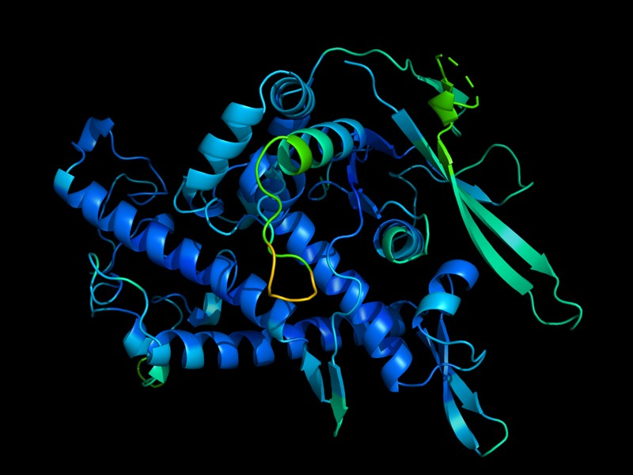
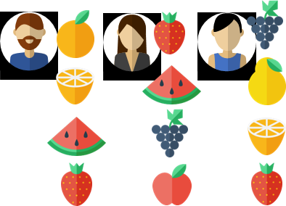
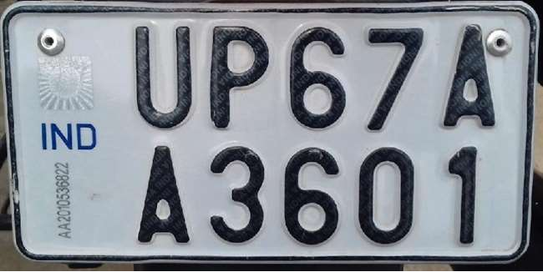
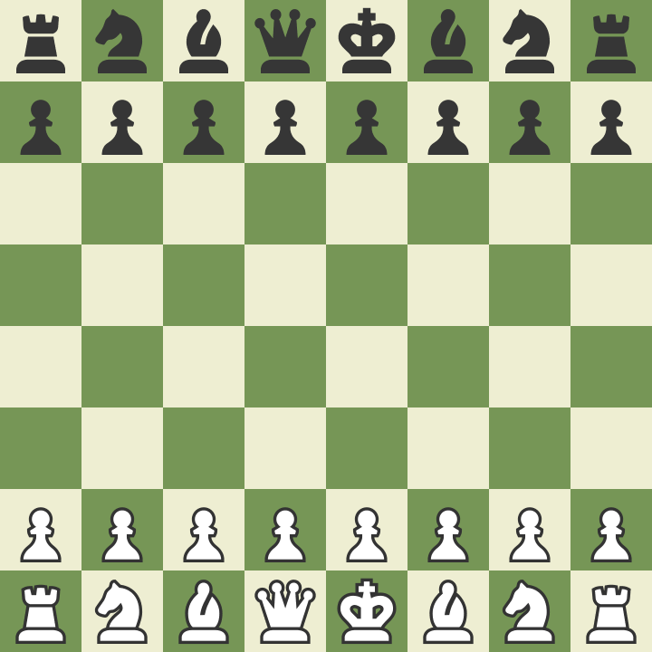


oyelecoupons.com
LICENSE PLATE IDENTIFICATION
nature.com
RECOMMENDATION
PROTEIN FOLDING
Fortunately, not. There are some basic ML techniques with which you can mix-n-match to solve more complicated problems
My name is Melbo
माझे नाव Melbo आहे
Do I need to learn a different ML technique for each problem?
bachelornation.com
chess.com
MACHINE TRANSLATION
“CONTEST” WINNER
GAME PLAY

Slide 2
ml primitives
after watching how many ml videos is it okay to update the skills section in one’s LinkedIn profile ?? … just asking for a friend …

Slide 3




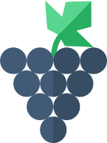




A typical Machine Learning cycle
TESTING
We get most popular ML primitives by looking at 3 things:
What sort of action we wish to take on test data
In what form is training data available to us
What sort of model we learn and how we learn it
TEST DATA
TRAINING
Code
Code
ML Algorithm
Written by a human ML expert
ML model
Produced automatically by the ML algo
TRAINING DATA
The ML way to solve an ill-understood task

Slide 4

ML primitives by type of action on test data
@
@
Subject: Tax Assessment
Sender: incometax.gov
Subject: New Post
Sender: reddit.com
This is often called binary classification since there are only two bins into which every test data point must be sent
What if I want more than 2 bins?
@
@
Subject: Free movie tickets
Sender: winfabulous.xyz
Subject: Friend Request
Sender: facebook.com
STRESSED
SPAM
HAPPY
NON-SPAM

Slide 5



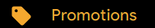


ML primitives by type of action on test data
@
@
Subject: Tax Assessment
Sender: incometax.gov
Subject: New Post
Sender: reddit.com
This is often called multi-class classification
What if I want to send a point to more than one bin?
What if I want to send a point to no bin?
@
@
Subject: Free movie tickets
Sender: winfabulous.xyz
Subject: Friend Request
Sender: facebook.com

Slide 6

ML primitives by type of action on test data
That is called zero-shot learning, which we might discuss later!
@
This is often called multi-label classification
Subject: Tax Assessment
Sender: incometax.gov
@
Subject: Friend Request
Sender: facebook.com
A data point maybe associated with zero or more labels
@
Subject: Free movie tickets
Sender: winfabulous.xyz
What if I want to add more classes or more labels later?
@
Subject: New Post
Sender: reddit.com
Money Matters
Work
Money Matters
Urgent
Entertainment
Work
Friends
Urgent
Family
Entertainment
Friends
Entertainment

Slide 7


ML primitives by type of action on test data
This is often called regression or real-valued regression to be more precise
@
0.63
Subject: Tax Assessment
Sender: incometax.gov
9.99
ML is as much an art as a science. Selecting the most suitable primitive brings out the artistic side of ML ☺
@
3.13
Subject: Friend Request
Sender: facebook.com
4.21
Didn’t we just solve spam detection as a binary classification problem?
@
4.38
Subject: Free movie tickets
Sender: winfabulous.xyz
1.01
Several real-life problems can be solved by ML in multiple ways. There are many other ways you can creatively use regression
@
1.56
Subject: New Post
Sender: reddit.com
7.82
0
5
1
10
Least likely to be spam
Not urgent at all
Definitely spam
I better check it ASAP

Slide 8
Exercise
Recall the daily activity A2 you had thought of (refer to the video “Getting Started”) for which it was difficult for you to specify a step-by-step procedure to solve it. Think of one or more ways in which the ML primitives we just discussed can solve that problem Hint: you may have to be creative in what you call a “data point” and what you call a “label”

Slide 9





A few mini-case studies
Technique 1: via multi-label classification
Treat the set of all possible fruits as the set of possible “labels”
Each user is a data point waiting to be tagged with fruits they like
Technique 2: via regression
This time a data point is a user-fruit pair
Each pair is to be assigned a value, say between 0 and 5 indicative of how much the user likes that fruit
Can you think of other techniques?
RECOMMENDATION
Very large number of labels if “fruits” are replaced by “all products on sale on Amazon”
$$\left( \right)=4.6$$
$$\left( \right)=3.8$$
$$\left( \right)=3.2$$
$$\left( \right)=1.3$$

Slide 10
A few mini-case studies
My name is Melbo
माझे नाव Melbo आहे
Often solved via multi-class classification
Treat each word in the Marathi dictionary as a “class”
Create a data point out of the English sentence and try to predict the first word of the Marathi sentence correctly
Now, change the data point to include the first Marathi word and try to predict the second word of the Marathi sentence correctly
Repeat till done
…
MACHINE TRANSLATION
मला गणना मराठी आम्ही माझे आहे आमच्या नाव Melbo चला
Yup, many modern ML apps have millions of classes
My name is Melbo → माझे
My name is Melbo, माझे → नाव
Yet again, very large number of classes!
My name is Melbo, माझे, नाव → Melbo
My name is Melbo, माझे, नाव, Melbo → आहे

Slide 11

Exercise
Think of how you might solve the other example applications we saw in the beginning using these primitives
Contest winner prediction
License-plate identification Hint: first find where the letters are located then find what they are
Protein folding Hint: predicting angles may give an idea of how chain is twisting
Game play
Some of these are very complex problems and several primitives may be needed for a good solution
Give it a try nevertheless … the goal is not to solve these problems rightaway but to start building intuition

Slide 12
ML primitives by form of training data
TEST DATA
Code
Code
ML Algorithm
ML model
TRAINING DATA
This is the most popular and simplest setting of learning and called supervised learning

Slide 13

ML primitives by form of training data
Even unlabeled data can be used to make the model more accurate – semi-supervised learning is a member of a broader class of methods for learning with weak supervision
TEST DATA
?
Code
Code
ML Algorithm
ML model
TRAINING DATA
Why not just throw the unlabeled points away?
This is called semi-supervised learning

Slide 14





ML primitives by form of training data
Don’t get confused by the name. In ML, online learning does not mean learning by watching YouTube videos ☺
There are a other related variants such as active learning and reinforcement learning – will discuss these in due time
Code
Code
ML Algorithm
ML model
This setting is called online learning and it promotes continuous learning
PREDICTED
TRUE

Slide 15
ML primitives by type of model
Geometric Models
support vector machines, ridge regression
Neural Models
multi-layer perceptron, convolutional networks, transformers
@
@
@
@
@
@
@
@
@
@
@
@
@
@
@
@
@
@
@
@
@
@

Slide 16


ML primitives by type of model
Probabilistic Models
logistic regression, Bayesian models
Models with Memory
learning with prototypes, k-nearest neighbors, decision trees
Distribution of
spam emails
Distribution of
non-spam emails
$$ℙ\left[spam | \right]<0.05$$
@

Slide 17
Summary
ML tasks are usually solved by creatively composing simple primitives
These primitives allow us to perform a variety of tasks on data such as classification, regression, ranking, etc.
They allow us to perform ML in a variety of settings e.g., supervised, weakly supervised, online, reinforcement etc.
They also allow us to use a variety of models to encode the laws and patterns we observe in data
ML primitives can be mix-n-matched to create innovative solutions
e.g., deep Bayesian reinforcement learning for recommendation

Slide 18
Stay Curious!
See you next time

